Slide 1
Efficient Phototherapy in the Management of Neonatal Jaundice
By
Dr. I Abdulkadir

Slide 2
Outline
Introduction
Case scenario
Challenges to efficient PT
Determinants of efficient
Light source (LED VS FL)
Method
Distance
Duration/ pattern
Guidelines for phototherapy
Term Vs preterm
Variation of effectiveness of phototherapy under different Circumstances
Maintaining efficiency of phototherapy
Conclusion
References

Slide 3
Efficient Phototherapy in the management of neonatal jaundice
Introduction
Neonatal jaundice (NNJ) remains a common problem worldwide
affecting 60 - 80% term/preterm. A major cause of neonatal admission
Severe jaundice (total bilirubin ≥ 20 mg/dl) increases the risk of ABE/Kernicterus
2.2-3.2% of neonatal admissions; 5-14% of neonatal mortality
Phototherapy remains a major component of care in NNJ
Provision of efficient optimal PT has been hindered in Nigeria by
Lack of access to PT devices capable of providing intensive PT (irradiance ≥ 30μW/cm²/nm)
Unavailability of irradiance measuring devices
Notes:
Worldwide, jaundice affects an estimated 13 million babies yearly, 9 million of whom are in developing countries with at least 10 000 globally at risk of extreme hyperbilirubinemia
Rebound hyperbilirubinemia is defined as a TSB concentration that reaches the phototherapy threshold for the infant’s age within 72 to 96 hours of discontinuing phototherapy.
Infants who receive phototherapy during their birth hospitalization are much more likely to experience rebound hyperbilirubinemia than those whose first treatment with phototherapy occurs on readmission
The overall risk of rebound has varied fivefold across studies, from 4.6%^{118,120,124} to approximately 24%

Slide 4
Case scenario
While on call in the neonatal unit of your hospital you received a referred 5 days old baby boy who was earlier admitted since the 2nd day of life when he was presented with history of fever from the first day of life and jaundice noticed at admission in the referring facility. He was referred to you for expert and further management due to progression of jaundice despite being on antibiotics and phototherapy for 3 days and has now developed newer features including, poor feeding, poor activity and abnormal posturing.

Slide 5
Phototherapy set up at the referring facility

Slide 6
Ineffective phototherapy
Poor to no efficacy therapy
Not just doing ‘phototherapy’ but actually doing phototherapy

Slide 7
Actually doing Phototherapy
Requires understanding-
Phototherapy as a treatment system-
a set of principles or procedures according to which something is done
an organized scheme or method.
Protocols
Guidelines
AAP guideline for PT in term and near term/ late preterm. Use of devices to deliver Intensive phototherapy (irradiance ≥ 30 µW/cm²/nm) measured at the baby's skin below the center of the phototherapy lamp
Notes:
The overall risk of rebound has varied fivefold across studies, from 4.6%^{118,120,124} to approximately 24%

Slide 8
Actually doing Phototherapy
Numerous factors affect the ability of a set up phototherapy system to effectively deliver intensive phototherapy

Slide 9
Challenges to efficient phototherapy
Quality & effective Phototherapy devices in use?
Encouraging efforts have gone into local fabrication (how efficient are these devices)
Branded, imported devices VS fabricated devices (are all branded devices efficient and always so?)
Gaps in understanding the determinants of efficient phototherapy
What determines effectiveness of a device VS efficacy
Could there be variation in effectiveness of a PT device under different circumstances?
Ability to maintain effectiveness of phototherapy devices
Efficacy of the phototherapy services
Effective phototherapy a key but not sole component

Slide 10
Determinants of Efficient phototherapy
Irradiance of a PT device
A function of quality of the light emitted (optimum wavelength in the range of 400–520 nm, with a peak of 460 ±10 nm and intensity of the light).
Distance of the device from the intended PT surface
Provision of intensive PT
The extent of exposure
Method of the phototherapy
Body surface exposed and reached by light foot print
Other non – phototherapy dependent factors
The duration of exposure to the dose of PT
Notes:
Factors that influence the efficacy of phototherapy include: the light wavelength and irradiance, bilirubin level, birthweight, gestational age, postnatal age, surface area exposed, skin thickness and pigmentation and the etiology of the jaundice. Lamps emitting light between the wavelengths of 400 - 500 nanometers (peak at 460nm) are specifically used for administering phototherapy as bilirubin absorbs this wavelength of light. The light is visible blue light and contains no ultraviolet light.
The higher the irradiance the larger the rate of bilirubin decline. There may be a saturation point at 30μ W/cm2/nm where an increase in irradiance has no increased benefit in decreasing bilirubin levels. But currently we do not know the maximum effective dose of phototherapy.

Slide 11
Phototherapy device light sources

Slide 12
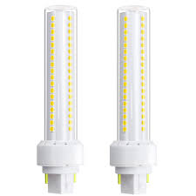
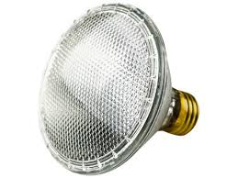
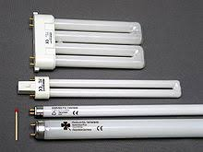
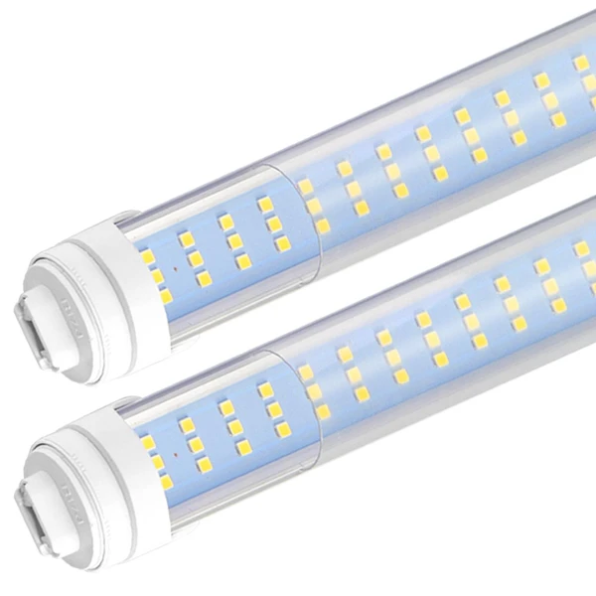
Phototherapy device light sources
HALOGEN LIGHT
FLOURESCENT LIGHT
(linear & compact)
LIGHT EMITTING DIODE
LED lamps have a lifespan many times longer than equivalent incandescent lamps, and are significantly more efficient than most fluorescent lamps ({florescent} 6000/15,000 VS {Halogen} 1000 VS {LED} 50, 000/ 60, 000 hours)
Notes:
A halogen lamp (also called tungsten halogen, quartz-halogen, and quartz iodine lamp) is an incandescent lamp consisting of a tungsten filament sealed in a compact transparent envelope that is filled with a mixture of an inert gas and a small amount of a halogen, such as iodine or bromine. The combination of the halogen gas and the tungsten filament produces a halogen-cycle chemical reaction, which redeposits evaporated tungsten on the filament, increasing its life and maintaining the clarity of the envelope. This allows the filament to operate at a higher temperature than a standard incandescent lamp of similar power and operating life; this also produces light with higher luminous efficacy and color temperature.fluorescent tube, is a low-pressure mercury-vapor gas-discharge lamp that uses fluorescence to produce visible light. An electric current in the gas excites mercury vapor, which produces short-wave ultraviolet light that then causes a phosphor coating on the inside of the lamp to glow. A fluorescent lamp converts electrical energy into useful light much more efficiently than incandescent lamps. The typical luminous efficacy of fluorescent lighting systems is 50–100 lumens per watt, several times the efficacy of incandescent bulbs with comparable light output.
Standard and halogen incandescent bulbs are much less efficient than LED and compact fluorescent lamps, and therefore have been or are being phased out in many places.

Slide 13
Phototherapy device light sources
Halogen lamps
Fluorescent light tubes {FL }(white light, blue light)
425- to 475-nm wavelength Bulbs used in this type of phototherapy unit include daylight, cool-white, blue, “special blue”
Light Emitting Diode (LED); power-efficient, low heat-producing light source, in the emission spectrum which overlaps the absorption spectrum of bilirubin and longer life span
Filtered sunlight
Notes:
potential to deliver high intensity light of narrow wavelength band in the blue-green portion of the visible light spectrum, which overlaps the absorption spectrum of bilirubin (BR

Slide 14
LED VS Fluorescent lamps
LED LAMPS
Use up to 80% more efficient
Convert 95% of their energy into light
Uses only 5% as heat
Requires far less power to provide a strong and consistent output at a lower wattage
Do not require a ballast
Saves 40- 60% energy cost compared to FL for same output
Half life about 50,000 hours in comparison to 3,000- 8/10,000 hours
Notes:
potential to deliver high intensity light of narrow wavelength band in the blue-green portion of the visible light spectrum, which overlaps the absorption spectrum of bilirubin (BR

Slide 15
Light Emitting diode VS Fluorescent Lamp phototherapy

Slide 16
Hindawi BioMed Research International Volume 2019, Article ID 6274719, 6 pages https://doi.org/10.1155/2019/6274719

Slide 17
Light Emitting diode VS Fluorescent Lamp phototherapy
Journal of Clinical and Diagnostic Research. 2021 Jul, Vol-15(7): SC08-SC10

Slide 19
Methods of providing phototherapy

Slide 20
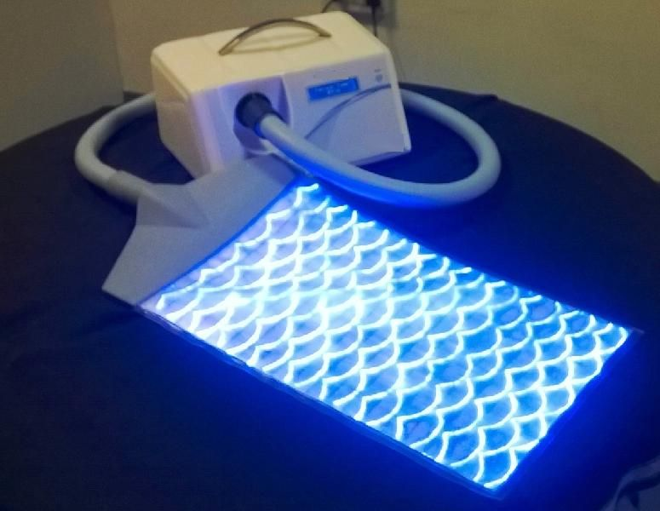
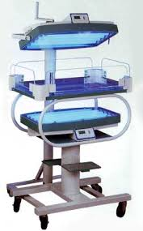
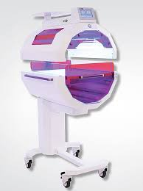
Methods of providing phototherapy
Notes:
Over head method
Underneath method
Double/ double surface method
Circumferential/ Total body method
Combined methods

Slide 21
Circumferential 360 Phototherapy device
Products & services/Neonatology/Accessories and consumables/Hammock for 360° phototherapy cradle

Slide 22
Method of providing phototherapy

Slide 23
Method of providing phototherapy

Slide 24
Optimal distance for phototherapy

Slide 25
Optimal distance for phototherapy

Slide 26
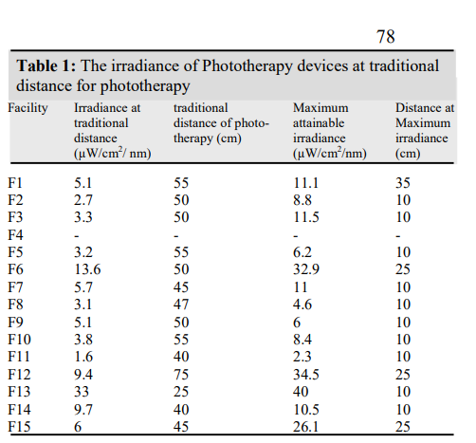
Optimal distance for phototherapy
Notes:
Distances ranged form 25- 75

Slide 27
Optimal distance for phototherapy

Slide 28
Optimal distance for phototherapy
Varying distances have been suggested
50cm
10- 30cm
25.5- 60cm
25- 75cm
20- 79cm
The relationship BW irradiance and Distance
Inverse relationship
Optimal distance is the distance that offers optimum desired irradiance, safety of the patient and no hindrance to observation, monitoring and care of the baby
Effective Treatment area minimum > 1300cm and optimum > 1800cm

Slide 29
Duration of phototherapy
Continuous VS intermittent

Slide 32
Indian J Med Res 153, April 2021, pp 446-452 DOI: 10.4103/ijmr.IJMR_2156_18

Slide 33
Variation in effectiveness of a PT device under different circumstances

Slide 34
Variation in effectiveness of a PT device under different circumstances
Inappropriate use of the device (distance/ partial light/ )
Fluctuating or erratic electric supply/ voltage
Poor maintenance culture
Use on Plexiglas or Perspex
Position of the device
Poor adherence to manufacturers’ user instruction (irradiance decay velocity and replacement of light)

Slide 35
Santosh Kumar K, Mangalabharathi S, Kamalarathnam CN, Evaluation of Factors Affecting the Phototherapeutic Properties of Commonly Used Phototherapy Units for Treatment of Neonatal Hyperbillirubinemia in India”: A Descriptive Cross Sectional Study. Progressing Aspects in pediatrics and neonatology 2018: 1;62- 8.

Slide 36
Maintaining effectiveness of phototherapy devices
Protocol availability
Adhere to protocol on effectiveness of device
Ensure steady electricity
Regular measurement of irradiance
Regular maintenance
Regular cleaning to Remove dust from lamps
Ensuring all bulbs are functional

Slide 37
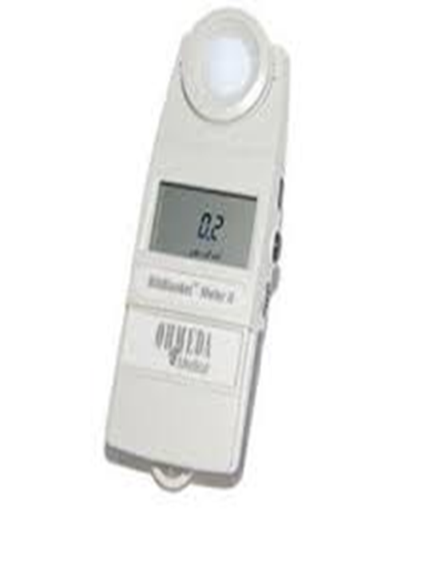
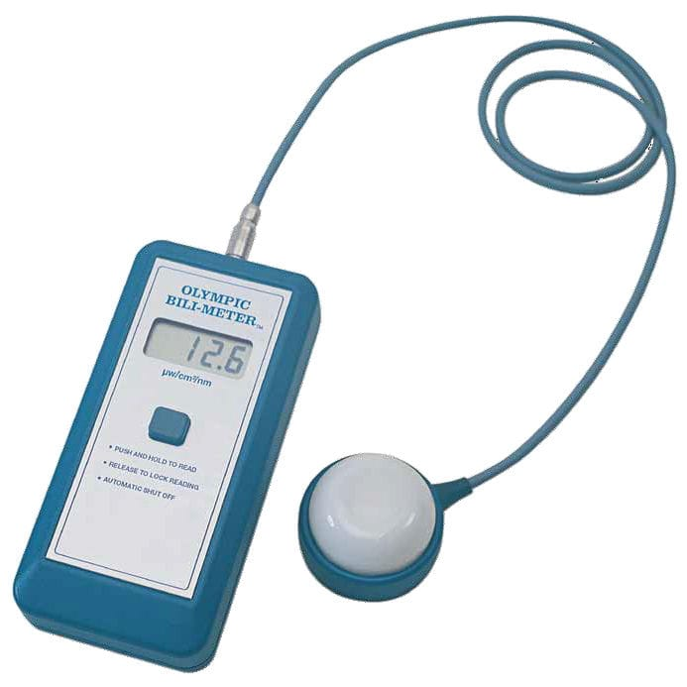
Regular measurement of irradiance

Slide 38
Available guidelines
Term VS preterm

Slide 39
Term babies and near term/ late preterm babies
The AAP 2004 guideline and the 2022 revised guideline
Recognizes conciseness of care protocol and system
Rightly and correctly cautions the usefulness of the guideline in resource- constrained settings

Slide 40
Preterm neonatal jaundice
No evidence-based guidelines are available on the indication for phototherapy in premature infants less than 35 weeks’ gestation,
Several protocol exist
A commonly used rule of thumb is to start phototherapy when the total serum bilirubin level is greater than 5 times the birth weight.
For a 1-kg and 1.5 kg neonates, phototherapy is started at a bilirubin level of 5 and 7.5 mg/dL respectively
Bilirubin BW index

Slide 41
Conclusion
Summary
Towards achieving efficient Phototherapy
Devices for PT should be adjustable to vary distance
Distance of PT should be that which limits complication to the minutest while guaranteeing optimum PT and care (including observation/ monitoring)
Devices should use light source in the optimal wavelength (475± 15 nm) such as special blue FL or LED lamps
The culture of measuring the irradiance of devices for optimal PT just as prescription should be adopted.
Use of devices and maintenance should follow manufacturer’s user guide

Slide 42
More Readings:
AR Borden, KM Satrom, P Wratkowski, TN George, CA Adkisson, HJ Vreman, AP Johnson, KJ Nichols, TM Slusher. Variation in the Phototherapy Practices and Irradiance of Devices in a Major Metropolitan Area. Neonatology. 2018; 113(3): 269–274. doi:10.1159/000485369.
I Abdulkadir, NM Adebiyi, G Adeoye, WNOgala. An evaluation of phototherapy services in newborn units in Kaduna State Nigeria. Niger J Paediatr 2018; 45 (2): 76 –80.
Benjamin K. Cline, Hendrik J. Vreman, Kelly Faber, Hannah Lou, Krista M. Donaldson, Emmanuel Amuabunosi, Gabriel Ofovwe, Vinod K. Bhutani, Bolajoko O. Olusanya, Tina M. Slusher. Phototherapy Device Effectiveness in Nigeria: Irradiance Assessment and Potential for Improvement. Journal of Tropical Pediatrics 2013: 59;321- 5.

